Slide 1
Critical Thinking

Slide 2

What is it?
A style of thinking.
Used to prioritise problems.
Relates problems to each other.

Slide 3

Where is it Used?
In every industry.
For every problem.
Even you use it.

Slide 4

Why do I Care?
Because you are going to get paid to do it.
Because it will save you a lot of frustration.

Slide 5
Bottlenecks

Slide 6
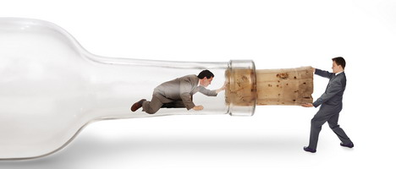
Bottlenecks
A Bottleneck is the slowest point in a system.
A system is only as fast as its slowest part.
So Bottlenecks cause a lot of problems.

Slide 7
Fixing Bottlenecks
This is where critical thinking comes in.
Bottlenecks can have a range of symptoms.
Stress for everybody involved.
Backlogs of work.
Delays in product shipment.

Slide 8
Fixing Bottlenecks
Don't simply treat the symptoms of a problem.
A lot of problems can be attributed to flaws in other parts of a system.
Think critically – how do the problems relate?
Slow internet
Using Eircom

Slide 9
Bit Twiddling

Slide 11
<<< REF PAGE >>>
http://magicalpenny.com/wp-content/uploads/2010/10/urgent-300x183.png
http://www.verticalfist.com/images/8directions
http://books.google.ie/books?id=jRWEvzORYDsC&printsec=frontcover&dq=critical+thinking+problem+solving&source=bl&ots=8dNGqj7anz&sig=I7Aj07btPb1_7WbaFbdaBEKdIUU&hl=en&sa=X&ei=nTRzUIjpGMrKhAee5ICgAQ&ved=0CDUQ6AEwAQ#v=onepage&q&f=false
http://www.onemoveforward.com/wp-content/uploads/2012/03/critical-thinking.jpg
http://www.mindtools.com/pages/article/newTMC_76.htm
http://www.xda-developers.com/wp-content/uploads/2012/07/Bottleneck.jpg?f39ce1
http://www.adayinthelifeof.nl/2010/06/02/deflating-the-universe/
Gary Stix. Proﬁle: David A. Huﬀman. Scientiﬁc American, 265(3):54, 58, September 1991.
http://books.google.ie/books?id=rKhiqILRK7kC&printsec=frontcover&dq=Huffman+Encoding&source=bl&ots=spJOcCc6yK&sig=dXy0lW3qss6LgVPnGs4rZvVWawY&hl=en&sa=X&ei=MCV7UNSEGILMhAfQ2IDoCA&ved=0CDsQ6AEwAg

